Slide 1
Visualizing Symbolic Execution with Bokeh
Asankhaya Sharma
SRC:CLR

Slide 2
Symbolic Execution (SE)
Analyzing a program to determine what inputs cause each part of a program to execute [Wikipedia]
The idea
Execute the program with an input
Build a symbolic formula during execution which captures the path taken by the input through the program

Slide 3
Path Condition (PC)
int max(int x, int y, int z){
int m = x;
if(y>m && y>z)
m = y;
else if(z>m)
m = z;
return m; }
max(1,3,2) = 3
Inputs: x₀,y₀,z₀
PC: true PC: m₀=x₀ PC: m₀=x₀∧y₀>m₀∧y₀>z₀ ∧m₁=y₀ Output: m₁

Slide 4
Execution Tree
true
m = x
m=x
y>m && y>z
…∧y>m∧y>z
…∧¬(y>m∧y>z)
z > m
m = y
…∧z>m
…∧¬(z>m)
…∧m=y
m = z
…∧m=z
return m

Slide 5
Path Exploration
PC: m₀=x₀∧y₀>m₀∧y₀>z₀∧m₁=y₀
PC1: y₀>x₀∧y₀>z₀∧3=y₀
Negate first constraint
PC2: y₀<=x₀∧y₀>z₀∧3=y₀
Check satisfiability using a constraint solver New Inputs: x₀=3, y₀=3, z₀=2
Repeat SE with new inputs

Slide 6
Why is SE useful?
Automated Fuzzing
Test Case Generation
Debugging Error Traces
Program Analysis
…

Slide 7
Bottlenecks
Path Explosion
Loops and recursion
Unbounded number of paths in a program
Constraint Solving
int is easy but what about other data types floats, strings, bit vectors etc.
Handling data structures with pointers

Slide 8

Exploiting Undefined Behaviors for Efficient Symbolic Execution [ICSE 14]

Slide 9
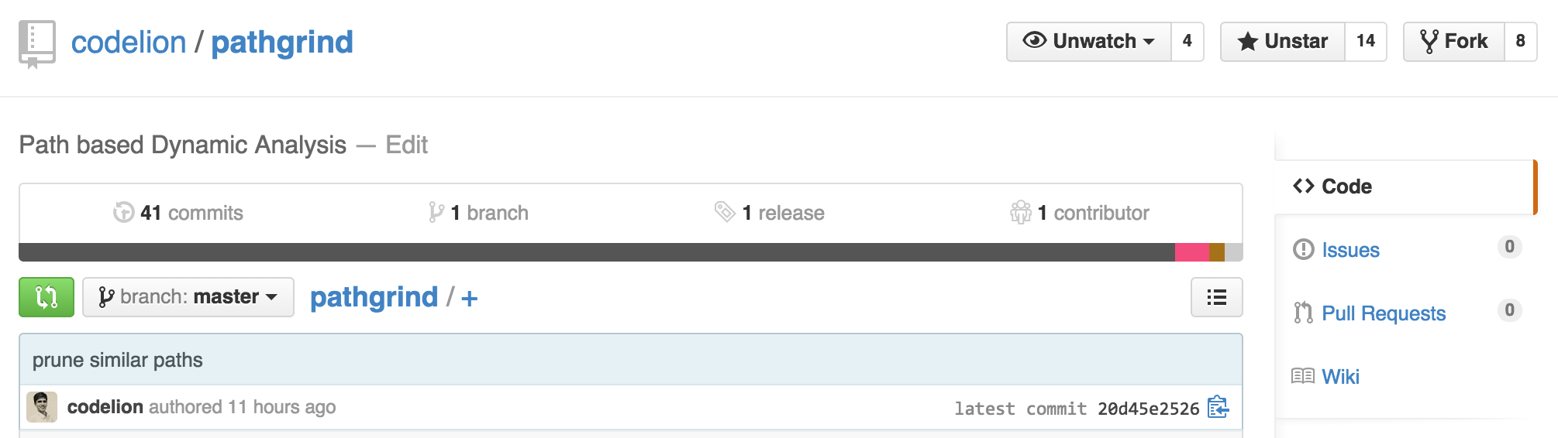
Demo 1
Symbolic execution with Pathgrind
fuzz/fuzz.py

Slide 10

Bokeh
Bo(w)-Ke(ttle)

Slide 11
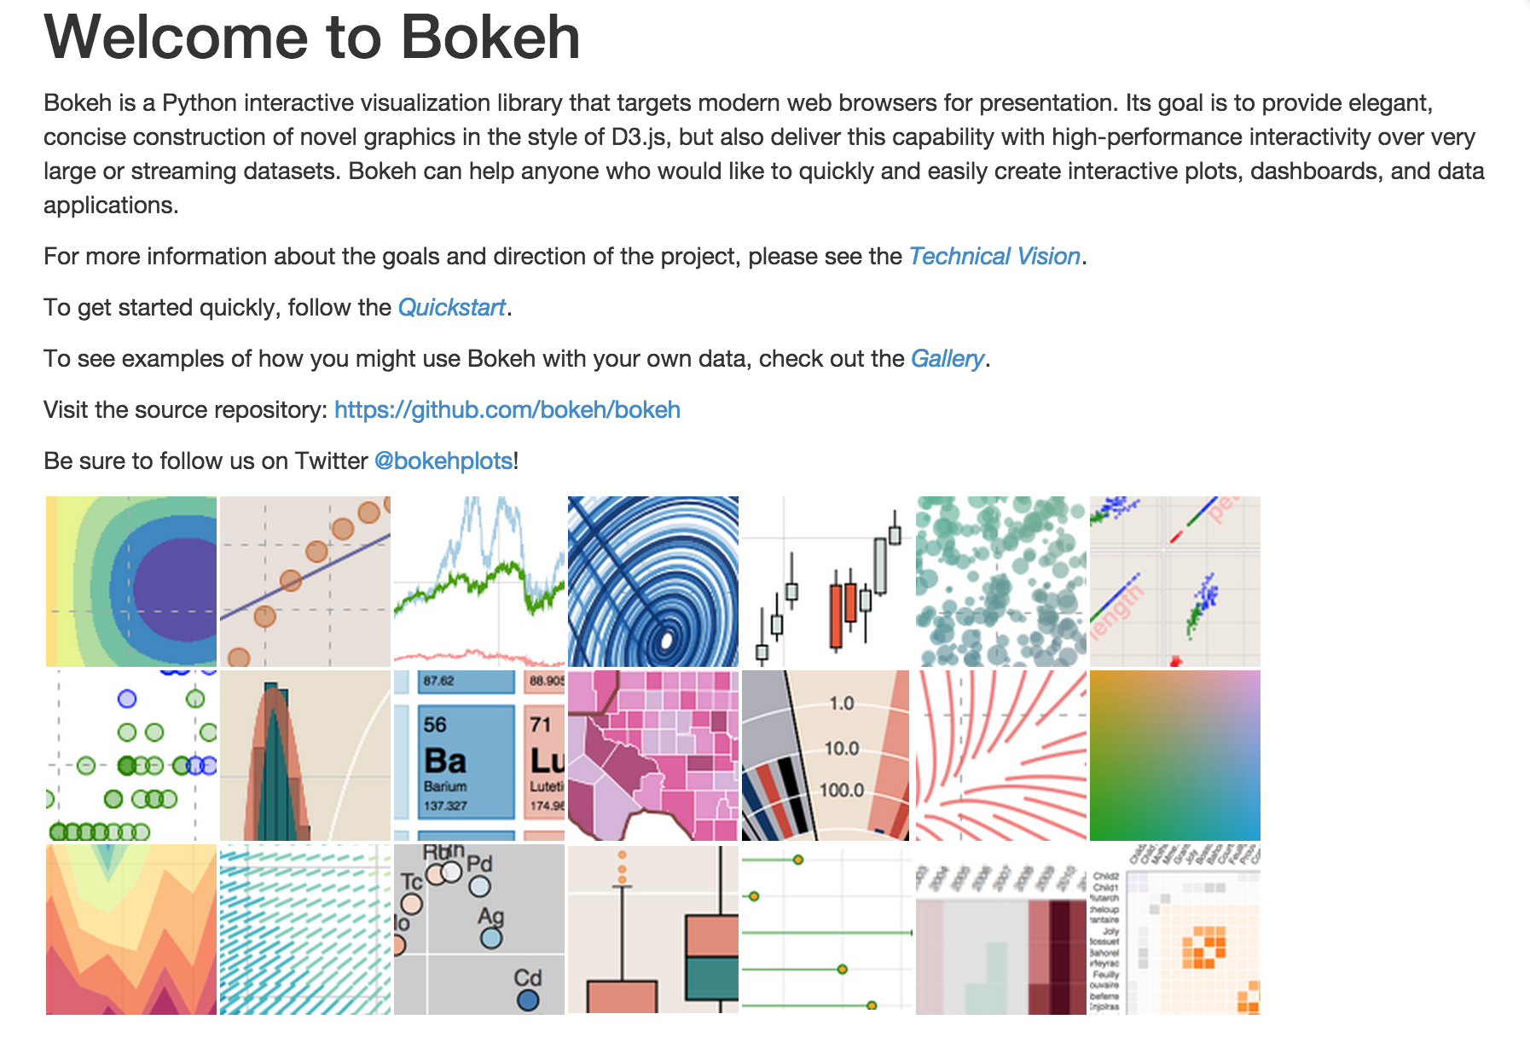

Slide 12

Demo 2
Plotting with Bokeh
Line Plot
Scatter Plot
Bokeh Server

Slide 13
Visualizing SE
Time Taken
Generate path conditions (path exploration)
Generate new inputs (by solving constraints)

Slide 14
Demo 3
Pathgrind + Bokeh = Visualize SE
fuzz/plotfuzz.py

Slide 15
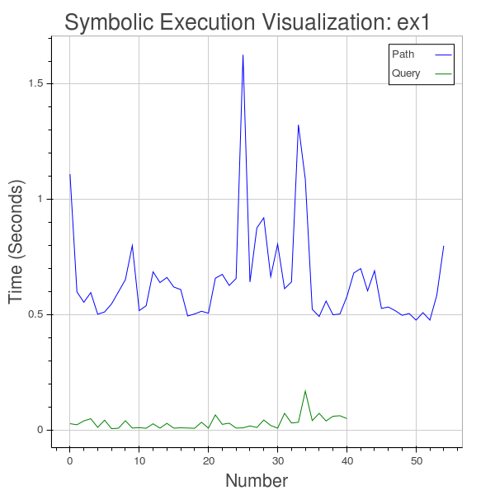

Slide 16
All paths are not equal
Use Levenshtein distance to measure the similarity between the path conditions when represented as strings
Scatter plot of similarity using Bokeh

Slide 17
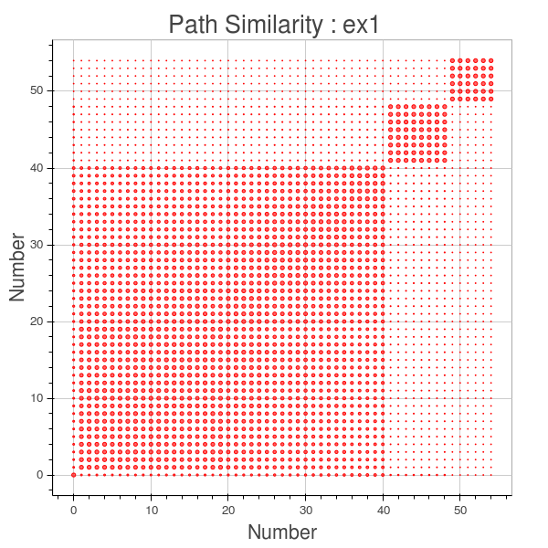

Slide 18
Optimization for SE
Prune paths that are >90% similar
As measured using Levenshtein edit distance

Slide 19
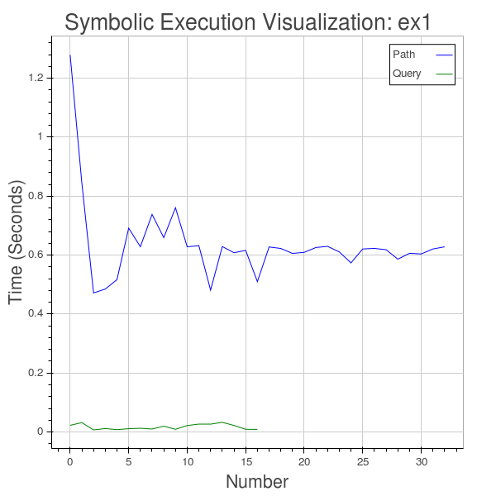

Slide 20
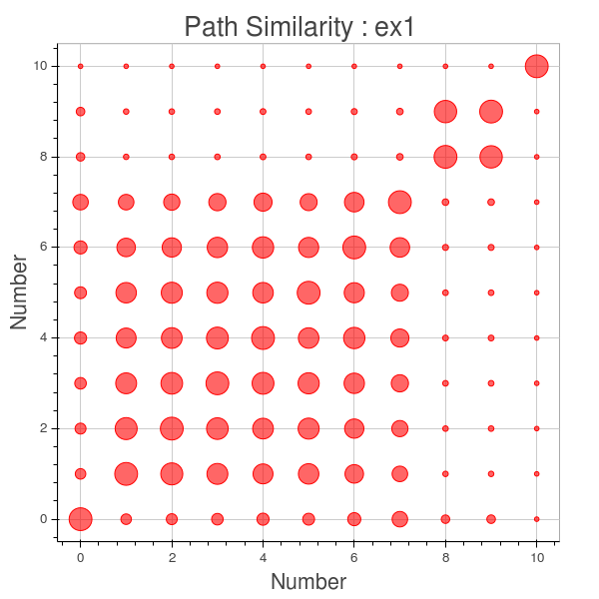

Slide 21
Take Away
Symbolic Execution
Using Bokeh to Visualize SE
Identify Optimizations for SE
Future
Statically Sampling of Paths
Probabilistic Analysis

Slide 22
We are hiring …
Shape the future of software security at SourceClear. By joining our team, you can help define the way modern developers identify and fix vulnerabilities in their code.
Check out https://jobs.lever.co/sourceclear

Slide 23
Thank You!
Questions?
Contact
Twitter: @asankhaya
Links
Source Code: https://github.com/codelion/pathgrind
Slides: http://asankhaya.github.io/ppt/PyDataSing.pptx

